Slide 1
SC-200T00A Microsoft Security Operations Analyst
Author name Date

Slide 2
Module 8: Perform threat hunting in Azure Sentinel

Slide 3
Module agenda
Explain threat hunting concepts in Azure Sentinel
Threat hunting with Azure Sentinel
Hunt for threats using notebooks in Azure Sentinel

Slide 4
Lesson 1: Threat hunting concepts in Azure Sentinel

Slide 5
Lesson introduction
After this lesson, you will be able to:
Describe threat hunting concepts for use with Azure Sentinel
Define a threat hunting hypothesis for use in Azure Sentinel

Slide 6
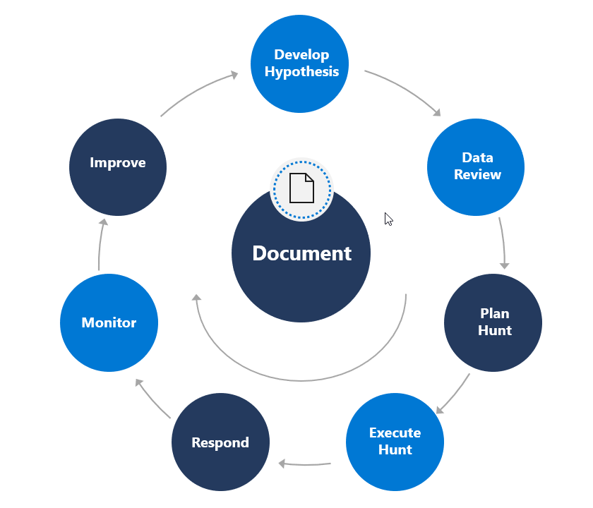
Cybersecurity threat hunting
Notes:
The term "threat hunting" is defined differently by different people. The most commonly used definition is the idea that you are proactively hunting through your
environment for a threat or a set of activities that you have not previously detected. The "not previously detected" part is what differentiates threat hunting from incident
response or alert triage. Threat hunting should be a continual process

Slide 7
Develop a threat hunting hypothesis
1
Keep it achievable.
2
Keep the scope narrow.
3
Keep it time-bound.
4
Keep it useful and efficient.
5
Keep it related to the threat model that you are defending against.

Slide 8
Section break

Slide 9
Lesson 2: Threat hunting with Azure Sentinel

Slide 10
Lesson introduction
After this lesson, you will be able to:
Use queries to hunt for threats
Save key findings with bookmarks
Observe threats over time with livestream

Slide 11
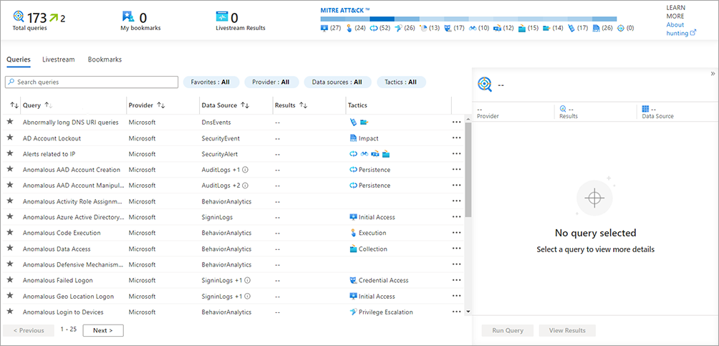
Manage Azure Sentinel threat-hunting queries
Create and run hunting queries to search for isolated security threats and unwanted activity.

Slide 12
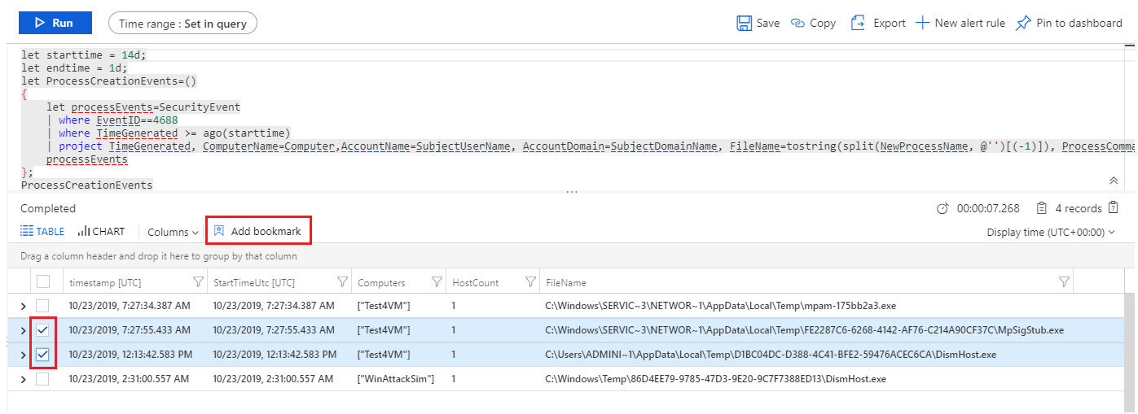
Save key findings with bookmarks
Bookmarks in Azure Sentinel can help you hunt for threats by preserving the queries you ran in Azure Sentinel, along with the query results that you deem relevant.

Slide 13
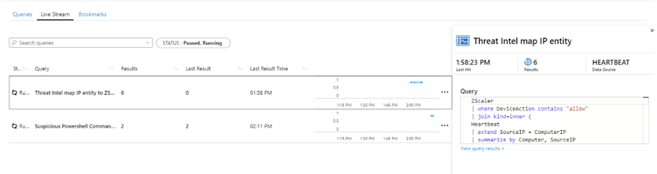
Observe threats over time with livestream
You can use the hunting livestream to test queries against live events as they occur. Livestream provides interactive sessions that can notify you when Azure Sentinel finds matching events for your query.
Notes:
Instructor demonstration:
Create a hunting query
Create a bookmark
Create a livestream

Slide 14
Section break

Slide 15
Lesson 3: Hunt for threats using notebooks in Azure Sentinel

Slide 16
Lesson introduction
After this lesson, you will be able to:
Explore API libraries for advanced threat hunting in Azure Sentinel
Describe notebooks in Azure Sentinel
Create and use notebooks in Azure Sentinel

Slide 17
Access Azure Sentinel data with external tools
The foundation of Azure Sentinel is the Log Analytics data store, which combines high-performance querying, dynamic schema, and scales to massive data volumes. The Azure portal and all Azure Sentinel tools use a standard API to access this data store. The same API is also available for external tools such as Python and PowerShell. There are two libraries that you can use to simplify API access
Kqlmagic
The Kqlmagic library provides an easy to implement API wrapper to run KQL queries.
msticpy
Microsoft Threat Intelligence Python Security Tools is a set of Python tools intended to be used for security investigations and hunting.

Slide 18
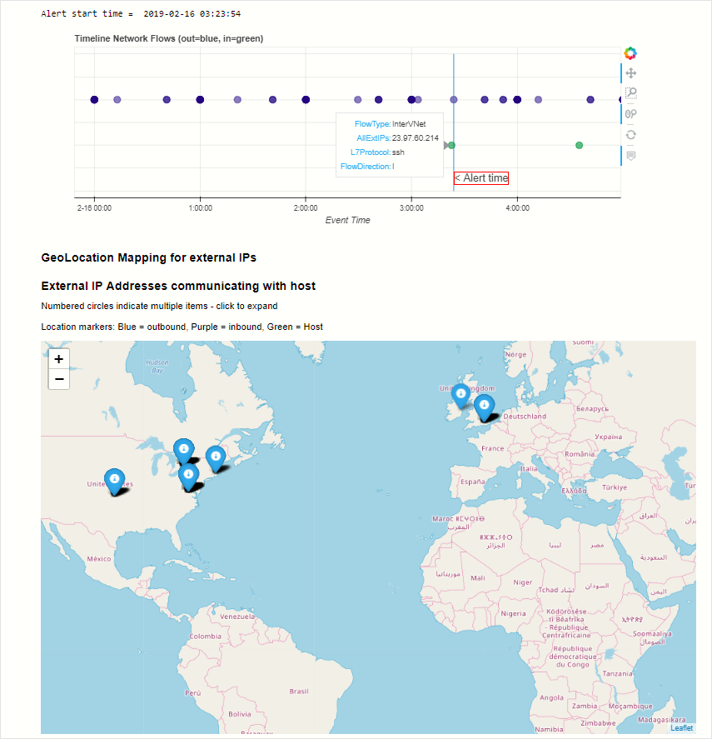
Hunt with notebooks

Slide 19
Create a notebook
Create a Notebook in Azure Sentinel Workbooks page
Create a Jupyter Notebook with tools like Visual Studio Code

Slide 20
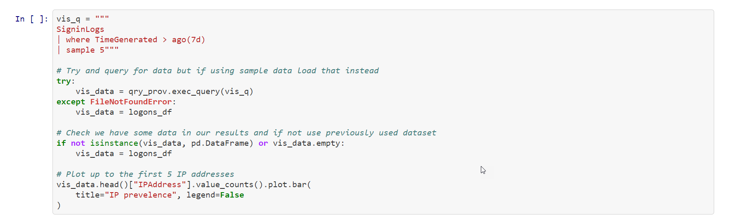
Explore notebook code
The following code blocks of the "Getting Started Guide For Azure Sentinel ML Notebooks" notebook provide a representative example of working with Azure Sentinel data.
Notes:
Instructor demonstration:
- Explore Notebooks

Slide 21
Section break

Slide 22
Knowledge check
Check your knowledge with the module quiz in your course viewer

Slide 23
Lab 1 –Threat hunting in Azure Sentinel

Slide 24
Lab Exercises
1
Exercise 1: Perform Threat Hunting in Azure Sentinel
2
Exercise 2: Threat Hunting using Notebooks with Azure Sentinel

Slide 25
Closing slide

